Slide 1
Mbot Speed Basics

Slide 2
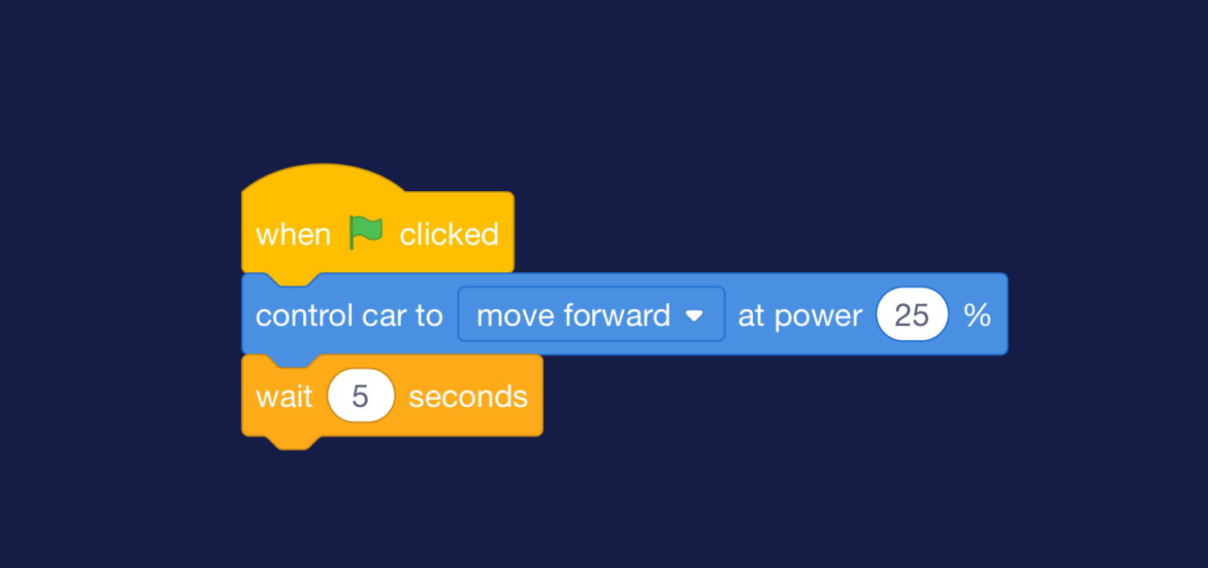
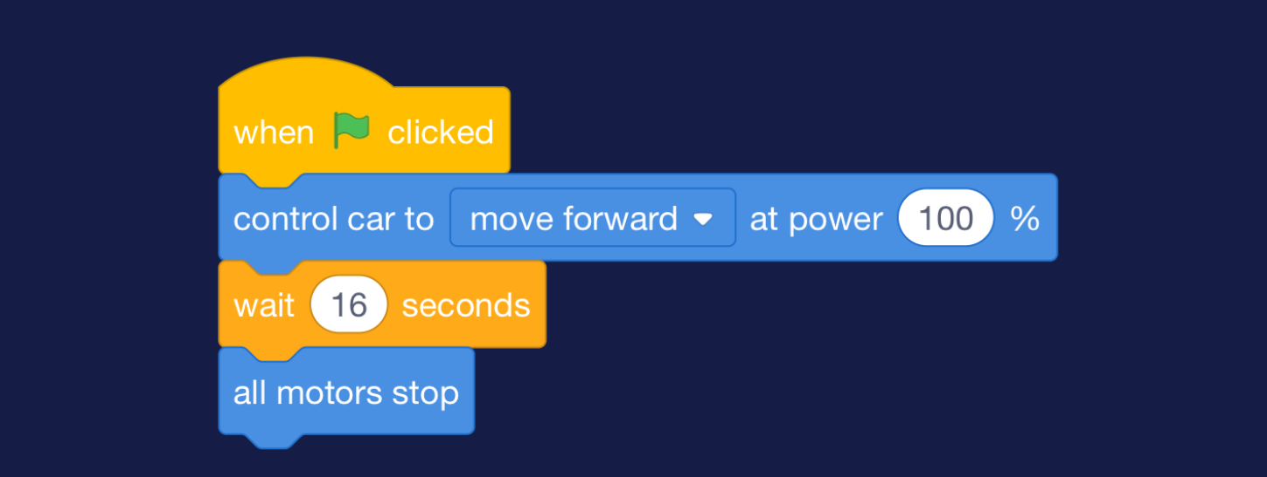
What is wrong in these pictures?
Picture #1
Picture #2

Slide 3

Start/Go
What it does:
It gives the command to run/start your code
Without it, Your code will not run!
Can only use once
Goes at the very start

Slide 4

Control speed
This block of code essentially controls the speed
Select “move forward” & set speed
Lower percentage = less power
Higher percentage = more power
Can be used multiple times

Slide 5

Wait x seconds
This code block makes mbot run for x seconds
Ex: 16 seconds means the mbot command block before it runs for 16 seconds
Can be used multiple times

Slide 6

All motors stop
Ends the full code
Can only use once
Goes at the very end

Slide 7
Now you know the basics, lets test Your debugging skills!

